Slide 1
India specific Actions And Advisory Options Related Human Genome Editing
Round Table on
Government Actions And Advisory Options Related Human Genome Editing
(before and after 2015)
S.R.Rao
Senior Advisor
Department of Biotechnology,
Ministry of Science and Technology
Government of India
Second International Summit on Human Genome Editing
The University of Hong Kong
November 27-29 2018

Slide 2
Rules 1989 0f Environmental Protection Act 1986
Legal provisions Regulating Genome Editing And Genetic Engineering In Organisms
Indian laws regulating process and products of genetic engineering also have legal provisions and definitions include specific references to effects of Genome Editing process.
The clauses (ii) and (iv) of rule 3 of Rules 1989 of E(P)A 1986 “Genetic engineering” is defined as the technique by which heritable material, which does not usually occur or will not occur naturally in the organism or cell concerned, generated outside the organism or the cell is inserted into said cell or organism. It shall also mean the formation of new combinations of genetic material by incorporation of a cell into a host cell, where they occur naturally (self cloning) as well as modification of an organism or in a cell by deletion and removal of parts of the heritable material.
Further rules 1989 also state that “These rules shall also apply to new gene technologies apart from those in clauses (ii) and (iv) of rule 3 ( referred above) and these rules shall apply to organisms /micro-organisms and cells generated by the utilisation of such other gene-technologies and to substances and products of which such organisms and cells form part.”
Genome editing regulated in India as process and product as it involves deletion or insertion of a nucleotide or a DNA sequence coding for a gene or regulatory element and may result in the development of a trait that may or may not existed in nature and the products

Slide 3
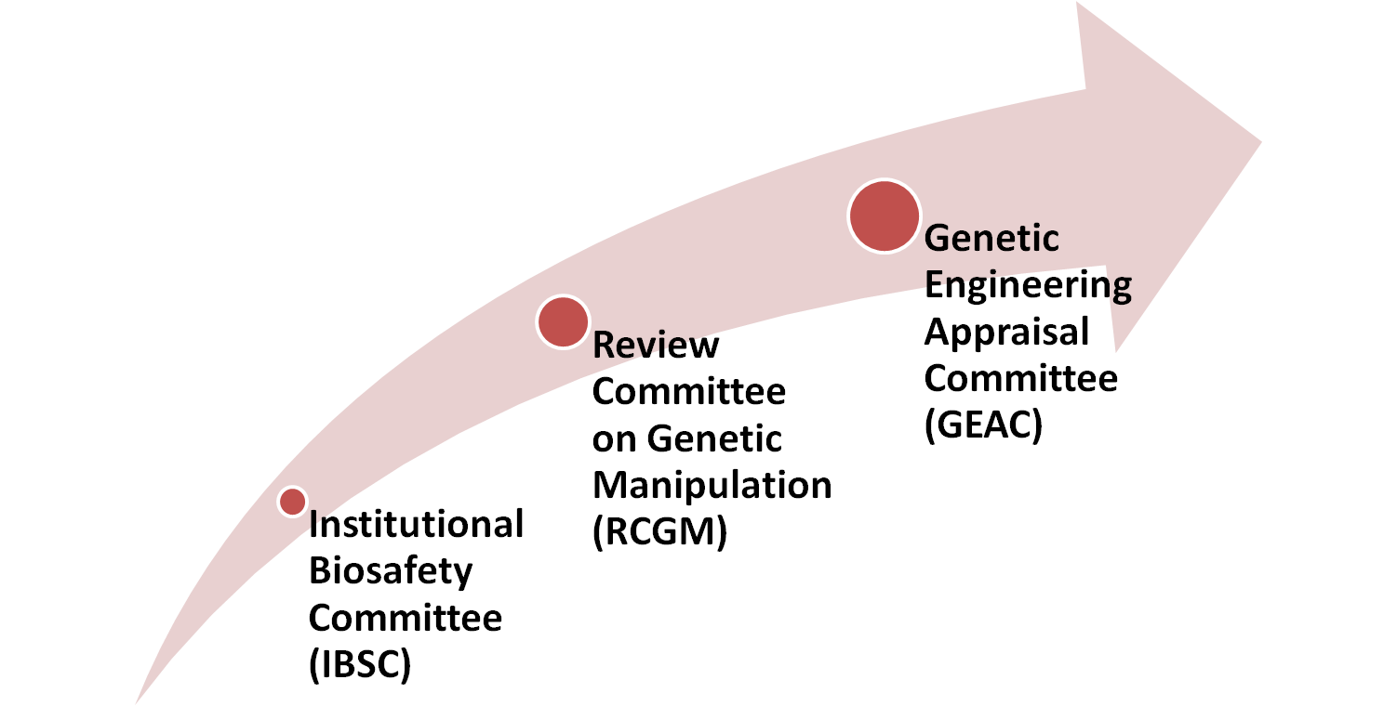
Implementing Ministries And Statutory Authorities Under Rules 1989, EPA 1986 And Drugs And Cosmetics Act, 1940
National/ Central
Drug Controller General of India
Ministry of Health and Family Welfare
MoEF&CC
DBT
Local
All activities in a Institute
Research
Large scale/ commercialization
DBT: Department of Biotechnology
Ministry of Science And Technology
MOEF&CC :
Ministry of Environment , Forests and Climate Change

Slide 4
Department of Biotechnology
Ministry of Science and Technology
Government of India
Initiates
Key points deliberated currently in developing
Policy Framework for Regulation and
principles of Risk assessment of
Genome Edited (GEd) Products/Organisms
Through consultations
Experts, inter-ministerial opinion and otherstakeholders

Slide 5
Government Actions And Advisory Options On A Developing Policy Related Genome Editing Of Organisms And Applications
Committee For National Policy On “Bio-innovations Through Genome Editing Applications
Apex Committee On Regulatory Policy On Biosafety And Biosecurity Genome Editing Of Organisms
Data Requirements For Genome Editing In Plants
Data requirements for Human genome Editing
Data Requirements For Genome Editing In Animals
Committee on Clinical trials Regime
Inter-Ministerial Pan Government of India
Approval

Slide 6
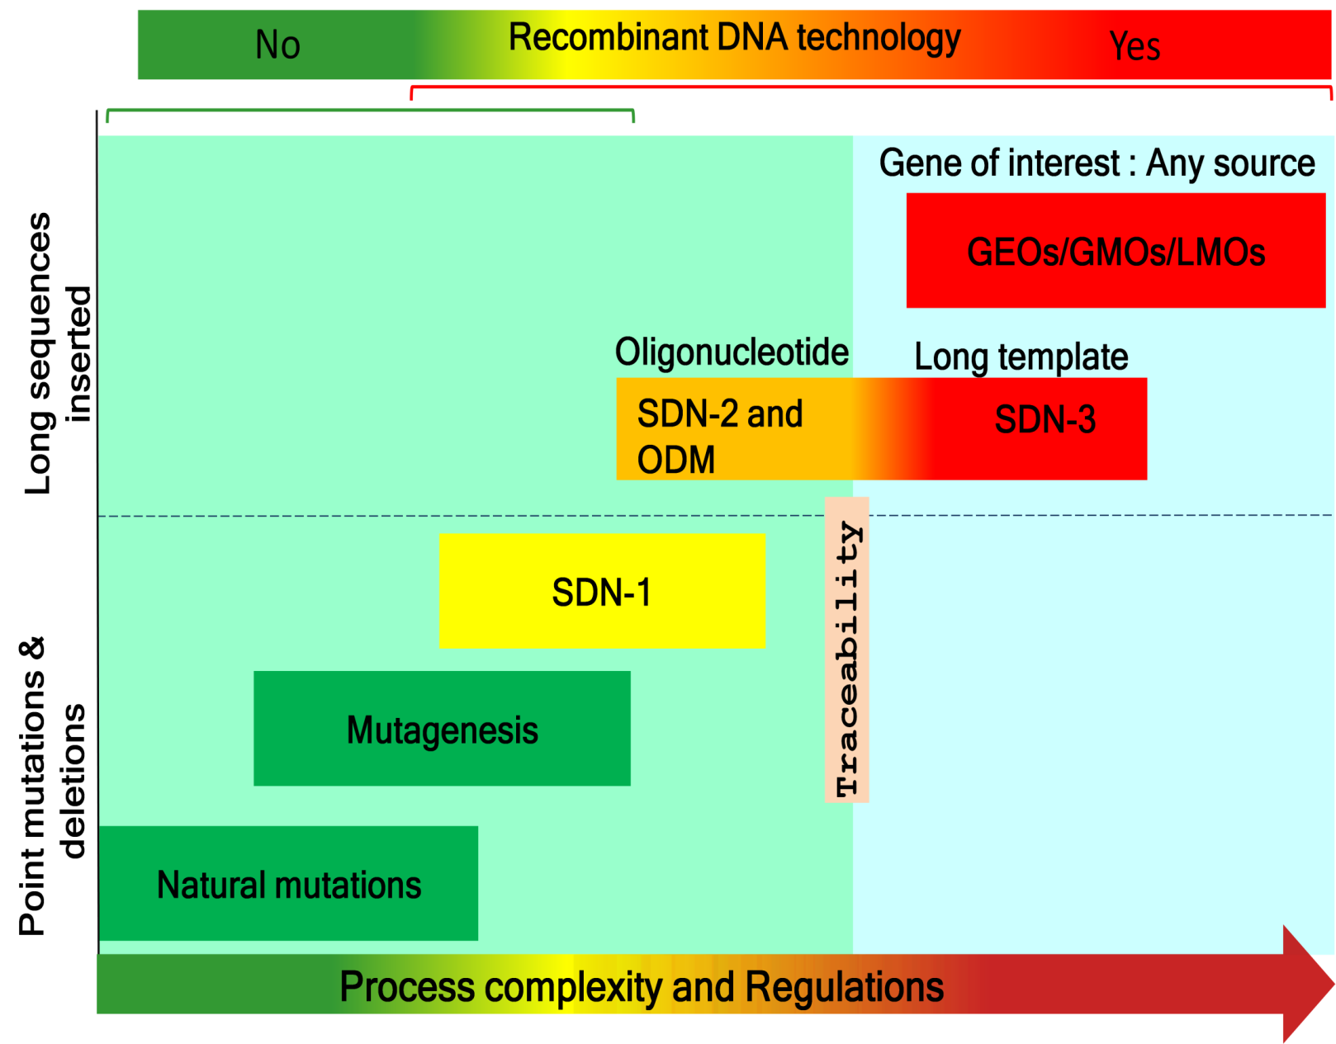
Evolving Policy Framework for Regulation …….
1.0 Understanding Process complexity, product features and traceability of Genome editing techniques relative to unregulated techniques

Slide 7
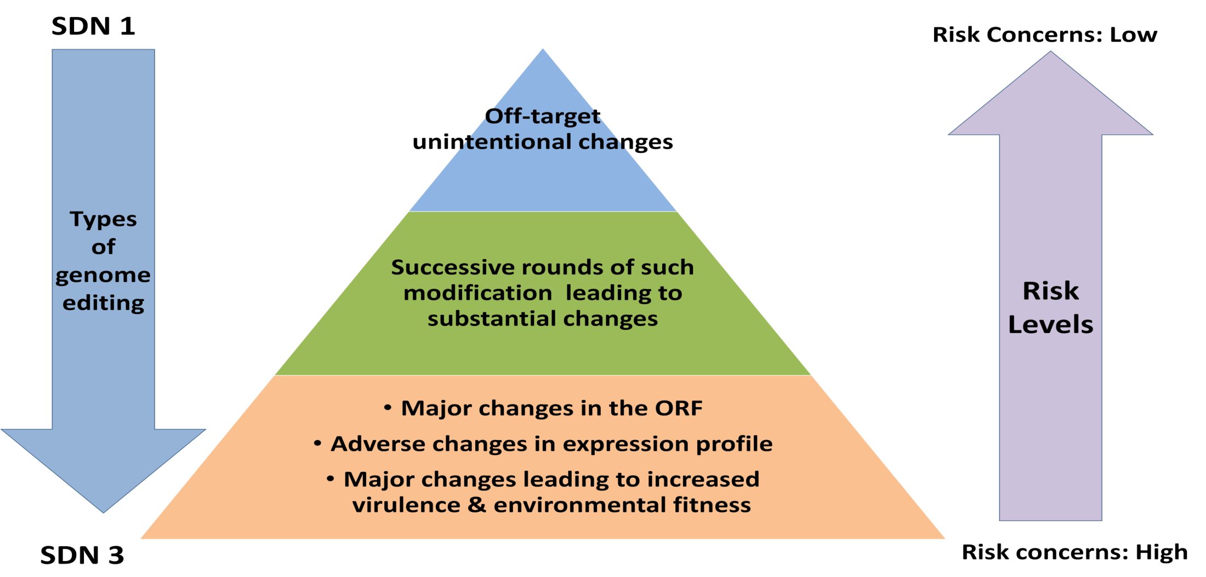
Evolving Policy Framework for Regulation ………
2.0. Risk scenarios in genome editing.

Slide 8
Evolving Policy Framework for Regulation ………
Intensity of Risk levels of site-directed nuclease technologies to the Categories of genome editing for risk assessment
 | Category
 | Category I | Category II | Category III
Method | Transient expression of PN | Stable introduction of rDNA with subsequent removal from the genome to generate rDNA-free null segregants | Stable plant genome integration of rDNA
SDN I Targeted DSB repairs involving NHEJ | Low/ Negligible | Low to Moderate | NA
SDN 2 & ODM Targeted DSB repairs involving by HR involving one or very few Nucleotides | Low | Low to Moderate | Moderate
SDN3 Targeted DSB repairs With insertion of large DNA | NA | Moderate | High

Slide 9
The Generic regulatory policy proposed was presented in various National and international meetings. with wider acceptance
International Conference On New Plant Breeding Molecular Technologies –Technology Development And Regulation” held on October 9, 2014 and October 10, 2014 in Hotel Le Meriden, Jaipur.
DBT sponsored panel panel on “Panel for Genome Editing “ at Indian Science Congress at Tirupati on 6th January 2016
20th ADNAT Convention: International Symposium on Genome Editing Technologies and their Applications in Biology, Medicine and Agriculture with a talk on “Evolving Indian regulatory Policy on Biosafety Assessment for Products Using Genome Editing Technologies” 16th to 18th February 2017
ICMR-INSERM-DBT Symposium On " Ethical And Scientific Issues Of Gene Editing Using Crispr-cas9 Technology on April 27th, 2017 at NII, New Delhi

Slide 10
The Generic regulatory policy proposed was presented in various National and international meetings. with wider acceptance
Third International Workshop for Regulation of Animal Biotechnology Hosted by the U.S. Department of Agriculture – Foreign Agriculture Service and Virginia Tech University Charlottesville, Virginia, USA, June 26-30, 2017
International Workshop "Assessing the Security Implications of Genome Editing Technology” October 11 - 13, 2017, Herrenhausen Palace, Hanover, Germany
Products of genome editing technologies and biosafety regulatory challenges In IN VITRO BIOLOGY 2018 MEETING. June 2 to 6, 2018 in Saint-Louis, Missouri.
Evolving Legal, Regulatory And Policy Strategies For Genome Engineering In General in Workshop Genome Engineering , IISc Bengaluru 24-29th June 2018

Slide 11
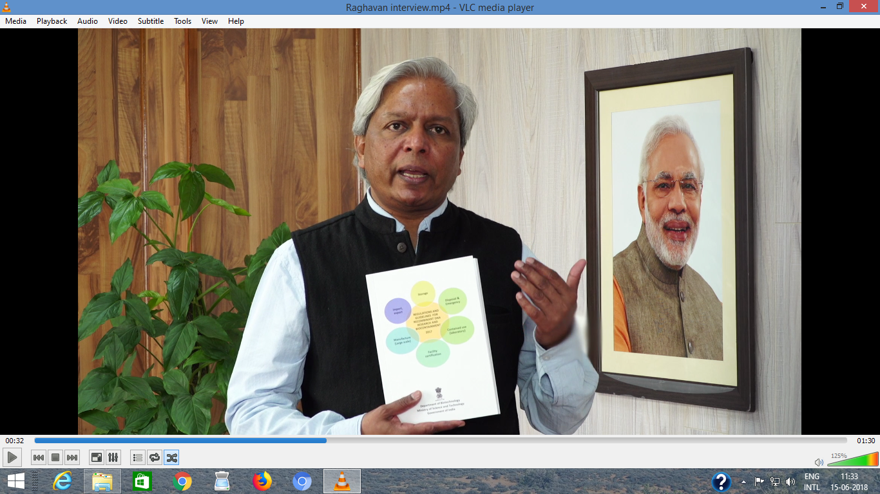
Notified. : Guidelines for R&D of genome editing organisms
including human cells under Rules 1989 of EPA, 1986
IBSCs are empowered in decision making process for
Inform IBSC for Genome editing Lab experiments of SDN1-type mutations.
Apply for authorisation by IBSC for Genome editing experiments of SDN2 and 3 -type modifications.
Released at the Meeting of States Parties of the Biological Weapons Convention (BWC) at Geneva, Switzerland on 5th December, 2017

Slide 12
Notified : National Guidelines For Stem Cell Research 2017
Indian Council for Medical Research Ethical guidelines 2006
Prohibited Areas of Research for human’s research is
“Any research related to germ line genetic engineering or reproductive cloning”.
New Guidelines ( 2017)
notified allows use of somatic cells for therapy and gene therapy with some conditions
subject to Rules 1989 of EPA 1986

Slide 13
Notified : National Ethical Guidelines for Biomedical and health Research involving Humans notified
The new guidelines have a total of 12 sections including Responsible Conduct of Research, Informed Consent Process, Vulnerability, Public Health Research, Social and Behavioural Sciences Research for Health, Biological materials, Biobanking and Datasets and Research during Humanitarian Emergencies and Disasters.
The section on ethics review process has been elaborated to help the many ethics committees who have doubt about the various procedures to be followed.

Slide 14

Notification pending : Drug Controller General of India (DCGI ) Ministry has clinical trials regimes for Somatic cell therapy include genome editing 2017
Stem Cell and Cell based Product means a drug which has been derived from processed cells including cell or tissue which has been processed by means of substantial or more than minimal manipulation with the objective of propagation and / or differentiation of a cell or tissue,' cell activation, and production of a cell-line, which includes pharmaceutical or chemical or enzymatic treatment, altering a biological characteristic, combining with a non-cellular component, manipulation by genetic engineering including gene editing & gene modification.

Slide 15
The Regulatory pathway for genome editing from for gene therapy –
R&D to Clinical trials-India
Guidelines for R&D of genome editing organisms
including human cells under Rules 1989 of EPA, 1986
Ethical clearance
Stem cell research Guidelines
Statutory bodies
Human
Clinical
DCGI/Drugs and cosmetic Act
Preclinical
Laboratory
IBSC
(RCGM/GEAC at federal govt level
Rules 1989,EPA 1986
Rules 1989,EPA 1986
Safety
Safety and efficacy
Safety and efficacy and unintentional changes
Ethical clearance

Slide 16
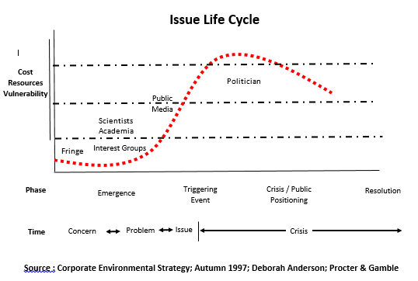
Public Policy proposed upfront on Genome Editing of organisms by the Government
As technology is evolving - 2017
Public Policy Genome Editing
Legal cases
Public Policy ????
Activists

Slide 17
Public Policy proposed upfront on Genome Editing of organisms by the Government
As technology is evolving - 2017
Vision
Mission
Priorities Of Research And Applications
Health Care,
Agriculture ,
Environment
Industry
Capacity Building
Human Resource With Skill Development
Research Resources And Infrastructure
Accelerated Genomics Research
Bioinformatics And Computation Biology
International Cooperation
Public -Private Partnerships
Regulatory And Risk Assessment
Policy And Pathway
Approach To Address Biosecurity Issues
Public Engagement
Pan- Government Oversight Agency
Outcomes And Outputs Relevant To Development

Slide 18
Acknowledgements :
Indian Council for Medical Research
Drug Controller General of India
Experts in various Scientific committee
Thanks

